Slide 1


NEW YORK
800 x1600
1200x1200

Slide 2
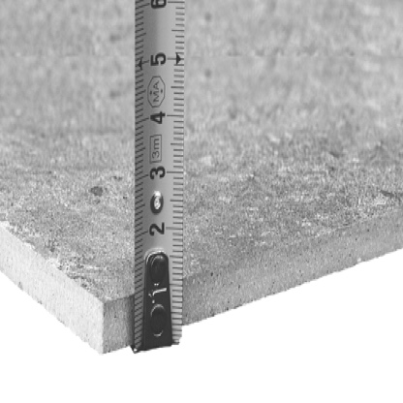
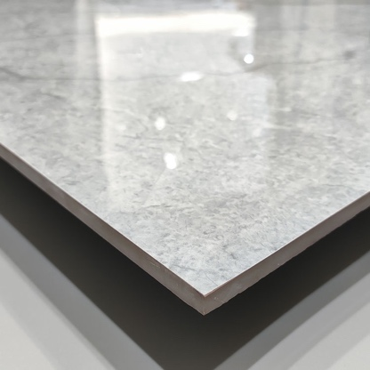
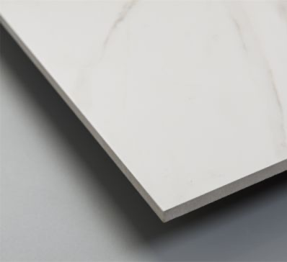
Information
Kích thước
SIZE
Độ dày 9mm
THICKNESS
Mài bóng
POLISHED
Mờ mịn
MATT SATIN
UNITED TILE
04
800x1600
PRODUCT
1200x1200

Slide 3







1200
1200
800
1600
NY1-P121201
Porcelain/ Polished/ Matt

Slide 4




1200
1200
800
1600
NY2-P121204
Porcelain/ Polished/ Matt

Slide 5






1200
1200
800
1600
NY3-P121201
Porcelain/ Polished/ Matt

Slide 6






1200
1200
800
1600
NY3-P121202
Porcelain/ Polished/ Matt

